Slide 1
Partnering to Eliminate Cervical Cancer in Alabama
Nancy Wright
Alabama Department of Public Health
September 2023

Slide 2
Eliminating Cervical Cancer: What Can You Do?
Join Operation WIPE OUT
Assess Your Region’s Needs
Become an ABCCEDP Provider
Become an Advocate in Your Region

Slide 3
Eliminating Cervical Cancer is Possible
HPV Vaccination
Cervical Cancer Screening
Appropriate Follow-up
Timely Treatment

Slide 4
World Health Organization Global call to Action to Eliminate Cervical Cancer
4 Key Strategies:

Slide 5
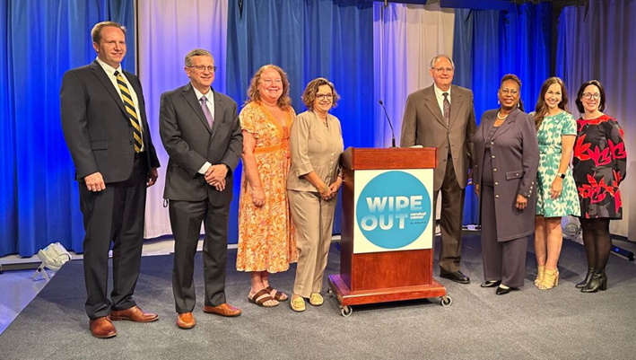
Press Conference: Action Plan to Eliminate Cervical Cancer in Alabama
Notes:
Launched

Slide 6
Operation WIPE OUT Cervical Cancer Alabama
Alabama is the 1st State in the Nation to Announce a Statewide Effort to Eliminate Cervical Cancer in Alabama
May 8, 2023

Slide 7
Chambers, Lee, Macon, Russell, and Tallapoosa County Regional Data
2024

Slide 8
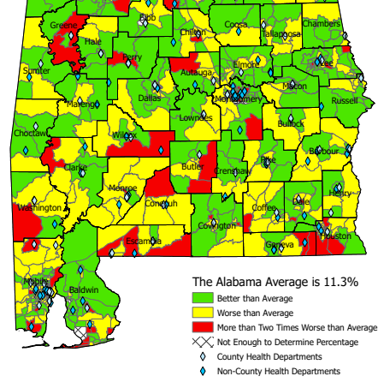
Uninsured Women Age 35-64 Census Tract, 2020
US Average: 10%

Slide 9
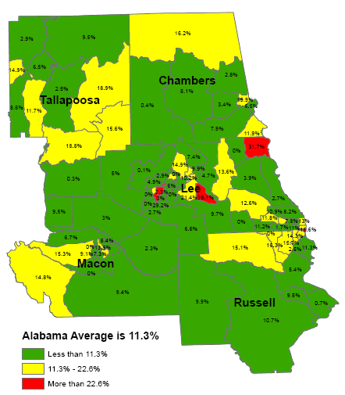
Uninsured Women Age 35-64 Census Tract, 2020
US Average: 10%
Notes:
The Alabama average of 14.3% below the poverty level is significantly worse than the US average of 10.2% for that age group. Likewise, the Alabama average of 11.3% with no insurance is significantly worse than the US average of 10.0% with no insurance for that age group.
Green means that Census Tract is at least better than the Alabama average, but does not necessarily mean it's good as it could still be worse than the national average.
Yellow means that Census Tract is the Alabama average or worse but not twice as worse. Keep in mind that means Yellow is also worse than the US.
Red means that Census Tract is more than twice as bad as the already terrible Alabama average.

Slide 10
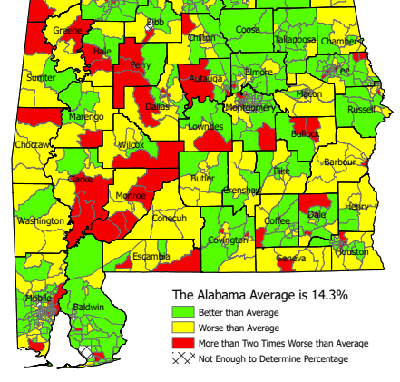
Federal Poverty Level Women Age 35-64 Census Tract, 2020
US Average:
10.2%

Slide 11
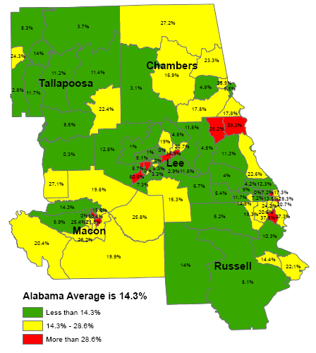
Federal Poverty Level Women Age 35-64 Census Tract, 2020
US Average: 10.2%

Slide 12
2023 HPV Vaccination Rates: 9-19 Years of Age
 | # Patients Up-to-Date Vaccine | % of Eligible
Chambers | 1,865 | 33%
Lee | 8,512 | 30%
Macon | 1,086 | 37%
Russell | 4,210 | 18%
State Rate: 28%
Alabama IMMPRINT Data: 2023

Slide 13
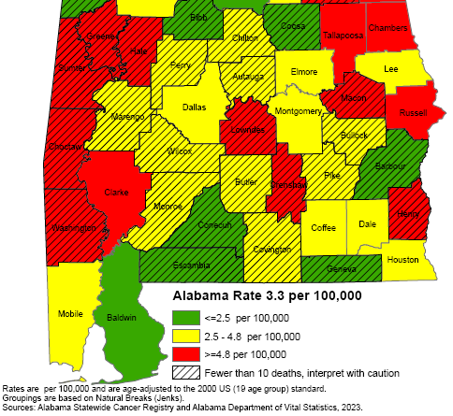
Cervical Cancer Mortality Rates: 2011-2020
National rate:
2.2 per 100,000

Slide 14
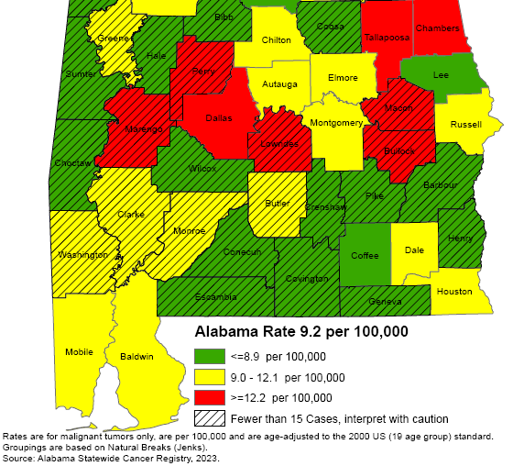
Cervical Cancer Incidence Rates: 2011-2020
National rate:
7.4 per 100,000

Slide 15
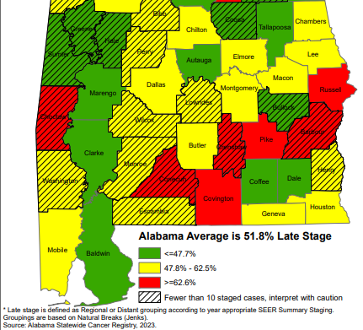
Cervical Cancer Late-Stage Cancer Rates: 2011-2020

Slide 16
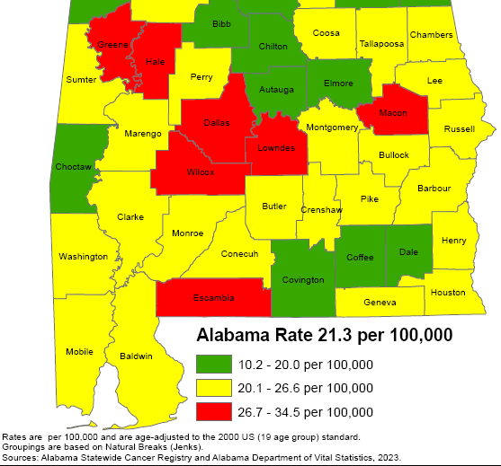
Breast Cancer Mortality Rates: 2011-2020

Slide 17
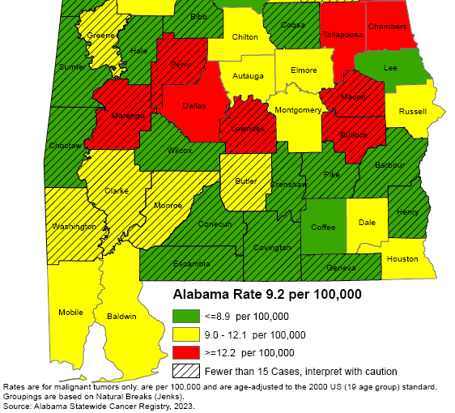
Breast Cancer Incidence Rates: 2011-2020

Slide 18
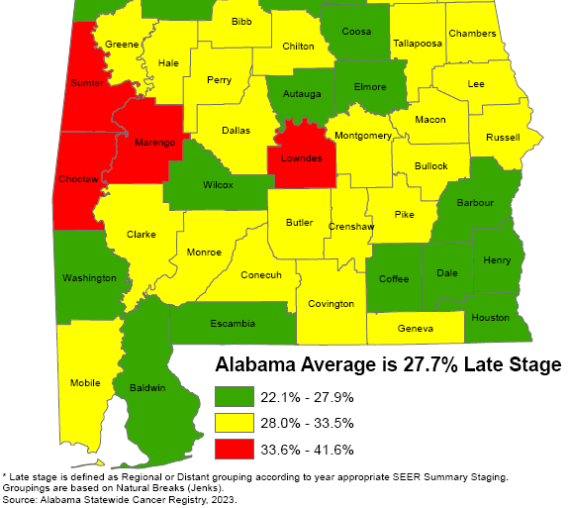
Breast Cancer Late-Stage Cancer Rates: 2011-2020

Slide 19
Alabama Breast and Cervical Cancer Early Detection Program (ABC)
Screening
Diagnostic Care
Treatment through Medicaid
No cost to the patient
Notes:
Services provided through 400+ contracted providers and county health departments.

Slide 20
ABC Eligible Women
Age 40-64
Income at or below 250% of Poverty Level
No insurance
Screening for Some High-Risk Women Under Age 40
65+ Medicare Part A Only
Notes:
-CDC provides funding to every state in the nation
-We can print up eligibility guidelines to handout if you’d like

Slide 21
How is the Program Funded?
CDC
State of Alabama
Joy to Life Foundation
Notes:
ACS

Slide 22
Who Provides the Medical Care?
400+ contracted providers statewide
Primary Care Providers
Gynecologists
Radiologists
Mammogram facilities
Surgeons
FQHCs
County Health Departments
Notes:
Services provided through 400+ contracted providers and county health departments.

Slide 23
Reimbursement for Providers
Medicare reimbursement rates
Office Visit $84.67
Pap/HPV testing $55.35
Genotyping (16/18) $40.55
Colposcopy w/biopsy $151.16
LEEP (Dx & Tx) $284.81
Mammogram $117.47
Mammogram dx $144.94
Ultrasound $95.33
Biopsy $54.32
Notes:
Services provided through 400+ contracted providers and county health departments.

Slide 24
Office Visit Reimbursement
Office Visit
Established (99213): $84.67
Pap/HPV Lab
Lab fee (88142): $20.26
Pap/HPV: (87624): $35.09 $140.02
Type 16/18 (87625): $40.55
Notes:
Services provided through 400+ contracted providers and county health departments.

Slide 25
Medicaid Treatment Act
Women Under 65 diagnosed with cancer
At/Below 250% poverty level
No Insurance
Under age 65
Live in Alabama
Legally in the U.S.
Documentation of Breast Cancer
Documentation of Pre- or Invasive Cervical Cancer
Notes:
Services provided through 400+ contracted providers and county health departments.

Slide 26
Medical Advisory Committee
Gary Pugh, M.D. ADPH Medical Officer Family Health Services Kaye Melnick, MSN, RN ADPH Chief Nursing Officer
Trina Simmons, NP ADPH Nurse Practitioner Director Family Health Services
Warner Huh, M.D. Gynecologic Oncology University of AL Birmingham O’Neil Cancer Center Donna Lynn Dyess, M.D. Breast Surgeon University of South Alabama Mitchell Cancer Institute
Jennifer Young Pierce, M.D. Gynecologic Oncology University of South Alabama Mitchell Cancer Institute
Stephen Varner, M.D. Obstetrics/Gynecology University of South Alabama

Slide 27
ABC Regional Data:
Chambers County
Lee County
Macon County
Russell County
Tallapoosa County

Slide 28
Women Screened by ABCCEDP
Alabama 2018 - 2022
Total Screened
Screened for Breast
Screened for Cervical
62,621 women ABC Eligible
Eligible: Women who have no insurance and with an income of <= 250% of federal poverty level and 40-64 of age

Slide 29
Cervical Cancer Screening 2018 -2022
Lee County: 51%
Chambers County: 15%
Tallapoosa County: 15%
Russell County: 13%
Macon County: 6%
4% of State
Notes:
2018: 177 2019: 257 2020: 105 2021: 121 2022: 220 Avg: 176-194…4% of State

Slide 30
Cervical Cancer & Pre-Cancer Detected 2018 - 2022
 |  | 2018 | 2019 | 2020 | 2021 | 2022
Lee | Cancer | 0 | 2 | 0 | 0 | 0
 | Pre-Cancer | 11 | 38 | 35 | 16 | 41
Chamber | Cancer | 0 | 0 | 0 | 0 | 0
 | Pre-Cancer | 0 | 9 | 2 | 0 | 1
Tallapoosa | Cancer | 0 | 0 | 0 | 0 | 0
 | Pre-Cancer | 2 | 5 | 2 | 3 | 6
Russell | Cancer | 0 | 0 | 0 | 0 | 0
 | Pre-Cancer | 3 | 8 | 2 | 0 | 2
Macon | Cancer | 0 | 0 | 0 | 0 | 0
 | Pre-Cancer | 0 | 1 | 0 | 0 | 0
Alabama | Cancer | 12 | 12 | 6 | 6 | 6
 | Pre-Cancer | 250 | 447 | 409 | 319 | 488
 | % Cancer | 0% | 16.67% | 0% | 0% | 0%
 | % Pre-Cancer | 6.40% | 14.09% | 10.02% | 5.96% | 10.25%

Slide 31
Number of Colposcopies in Alabama: 2022
Lee County 63
East Alabama Medical Center – Lanier 1
Lee County Health Department 21
Premier OBGYN, LLC 18
The East Alabama Health Care Authority 23
Alabama: 762
Notes:
48%

Slide 32
Breast Cancer Screening 2018 -2022
Lee County: 46%
Chambers County: 15%
Tallapoosa County: 14%
Russell County: 17%
Macon County: 8%
9% of State
Notes:
2018: 768 2019: 918 2020: 498 2021: 673 2022: 770 Avg: 725-782…..9% of state

Slide 33
Breast Cancer Cases Detected 2018-2022
 | 2018 | 2019 | 2020 | 2021 | 2022
Lee | 2 | 3 | 1 | 0 | 4
Chamber | 0 | 0 | 0 | 0 | 0
Tallapoosa | 0 | 0 | 1 | 0 | 0
Russell | 1 | 0 | 0 | 0 | 0
Macon | 0 | 0 | 0 | 1 | 0
Alabama | 108 | 110 | 97 | 100 | 78
 | 3.70% | 2.73% | 2.06% | 0% | 6.41%

Slide 34
Alabama Department of Public Health and Colposcopies
Nurse Practitioners (NP) certified for colposcopy
NPs supported by Medical Officer for Family Health Services
One NP per six Districts
Travel to health departments within Districts to provide colposcopy statewide
823 performed this FY (Last FY 23)
72% Show rate
24% High grade result

Slide 35
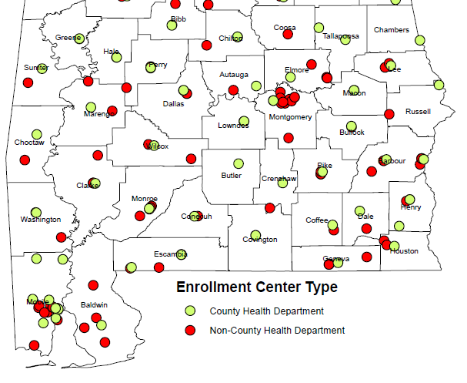
ABC Enrolling Providers

Slide 36
ABC Enrolling Providers
Chambers County
Chambers County Health Dept-Valley
QOL Health Svcs Inc - Chambers Quality Health Care
Lee County
Lee County Health Department
Mercy Medical Ministry
Premier OBGYN, LLC
Surgical Clinic, PC
Macon County
Macon County Health Department
QOL Health Svcs Inc - Tuskegee Quality HC Center
Russell County
QOL Health Svcs Inc - Susie E. Allen Health Center
Russell County Health Department
Tallapoosa County
Russell Med Center - Health Partners of New Site
Tallapoosa County Health Department, Alex City
Tallapoosa County Health Department, Dadeville

Slide 37
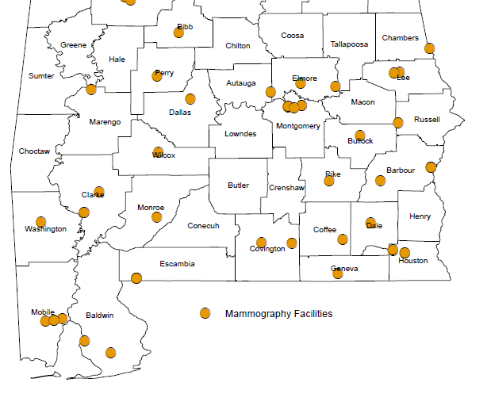
ABC Mammogram Providers

Slide 38
ABC Mammogram Providers
Lee County
Alabama Imaging, PC
Bridgeway Diagnostic Radiology, LLC - Auburn
Bridgeway Diagnostic Radiology, LLC - Phenix City
East AL Medical Ctr - Auburn Diagnostic Center
East Alabama Medical Center - Lanier
The East Alabama Health Care Authority
Tallapoosa County
Russell Medical Center

Slide 39
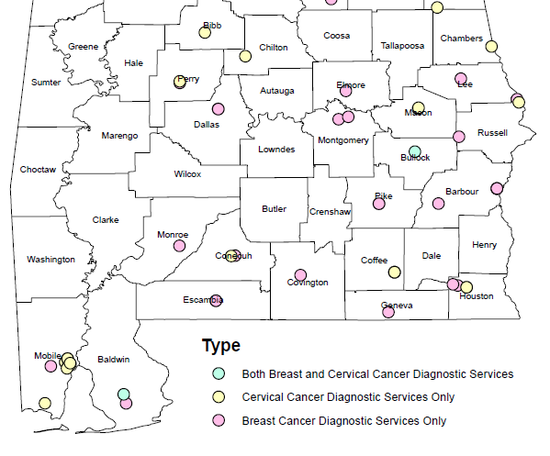
ABC Diagnostic Providers

Slide 40
ABC Diagnostic Providers
Premier OBGYN, LLC: Lee County
Bridgeway Diagnostic Radiology, LLC - Auburn
Bridgeway Diagnostic Radiology, LLC - Phenix City
East AL Medical Ctr - Auburn Diagnostic Center
East Alabama Medical Center - Lanier
The East Alabama Health Care Authority
OB-GYN Associates at Russell Medical Center
Surgical Clinic, PC
Lee County Health Department
UAB Medical Russell Medical Cancer Center
Russell Medical Center UAB Medicine Surgery Clinic
Russell Medical Center Anesthesia Services of Birmingham

Slide 41
Contact Information
ABC Hotline:
1-877-252-3324
https://www.alabamapublichealth.gov/bandc/
ABC Medicaid Treatment
Kelli Hardy
334-206-2976
Kelli.Hardy@adph.state.al.us
Contracts/More Information:
Nancy Wright
334-206-5851
Nancy.wright@adph.state.al.us
Notes:
Dr. Pierce, HPV Impact on Cervical Cancer
Become ABC Provider
Join Operation WIPEOUT: Vaccine, screening, and Appr FU

Slide 42
Please complete the Evaluation in your packet or through the link in the Zoom Chat
Thank you for Attending!

